Slide 1
Problem Statement 7
Access Control Monitoring & Review
Project Handled By:-
Dhruv Dixit
Sneha KJ
Sushank Yadav
Priyesh Shetty
Shaikh Juneid

Slide 2


Access Control Monitoring & Review
Executive Context - Why we need This System
ICICI AMC must ensure secure and compliant access to business – critical applications.
Currently quarterly access reviews are manual, slow, lengthy and error prone.
Lack of centralized visibility leads to stale or unauthorized access risks.
Regulatory bodies demand full audit traceability & timely certification of user access every quarter.
ICICI AMC must ensure secure and compliant access to business – critical applications.

Slide 3

Current Challenges in ACM
Quarterly access reviews are manual -> time consuming & inconsistent.
Managers & Business Owners lack centralized visibility of user access across applications
Difficulty in tracking who approved what and when
High reliance on Emails, Excel sheets, and follow ups.
Delayed review cycles and Limited Audit trail.

Slide 4
Proposed Solution - ACM
Users & Access Data
Automated Workflow Engine
Reporting manager
App Owner
Business Owner
Centralized portal for managing user access across all critical applications.
Automated quarterly access review workflow with smart email triggers.
Three level approval process: Reporting manager → App Owner → Business Owner
Real – time access updates with full audit trail and decision history
Dashboard for Visibility into Pending, Approved & Rejected access items.
Secure Audit Repository

Slide 5

Key Stakeholders & Responsibilities
Admin
Manages users, applications, quarterly trigger settings.
Control Governance configuration & system access.
Reporting Manager
Maintains user access for team members.
Performs 1st level quarterly access review.
Application Owner
Validates Manager recommendations
Reviews access based on application needs (2nd Level Approval).
Business Owner
Ensures access aligns with business & compliance requirement.
Final decision authority – Approve / Reject Access Retention

Slide 6
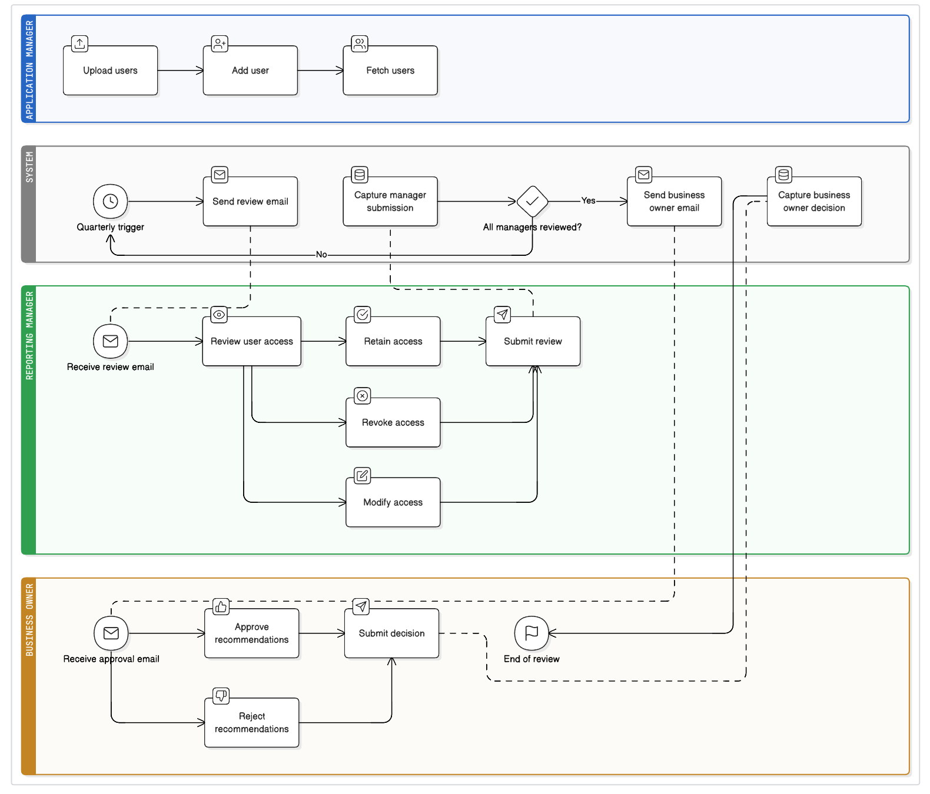
System Architecture Overview
Centralized Web Portal
Backened services perform workflow, approval routing & audit logging
Integration with Email/Scheduler for automated quarterly triggers
SQL Server DB for access data, review cycles & history
Built with scalable & secure architecture to onboard more applications.

Slide 7
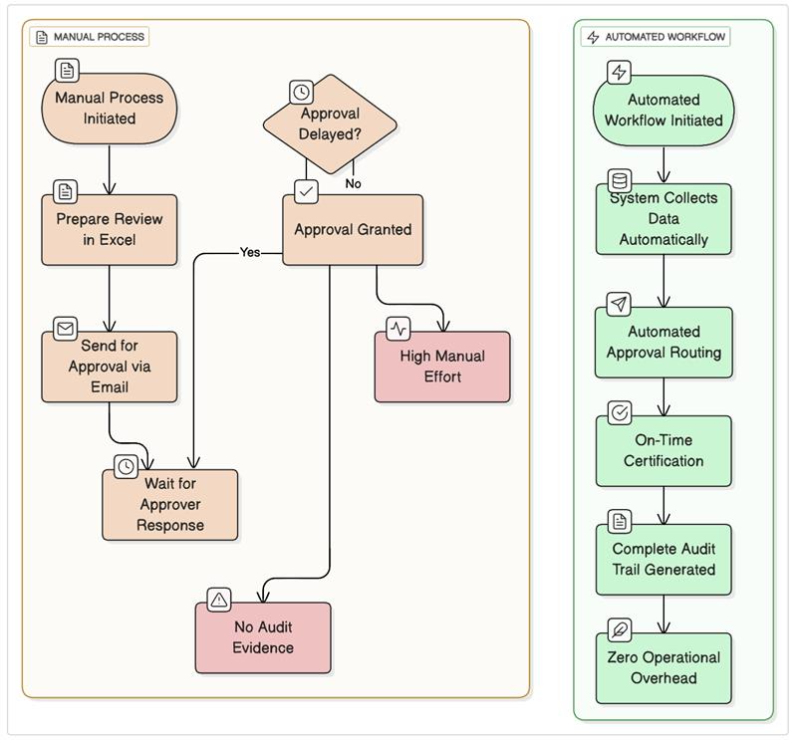
Business Benefits and Outcomes

Slide 8

Ensuring secure, compliant & Audit ready access across all applications

Slide 9
Thank you

